Slide 1
Significant Figures

Slide 2
We already know how to round to a number of decimal places. An alternative is to round to a number of significant figures.
For example, instead of rounding 1.79803 to 2 decimal places, we might round to 3 significant figures instead.

Slide 3

Significant means important or having meaning, so a significant figure is a number that tells us something important about the value that it represents.
The number of significant figures is a measure of how accurate a number is.
For example, the number 23 has 2 significant figures. This is less accurate than the number 23.4, which has 3 significant figures.
Let's look at which numbers are considered significant, and which are not.

Slide 4
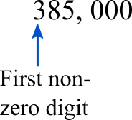
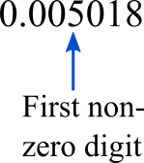
All non-zero digits are significant. The number of significant figures is counted starting from the first non-zero digit.
The first non-zero digit in a number is always the most significant, because it tells you the most information about the number.

Slide 5
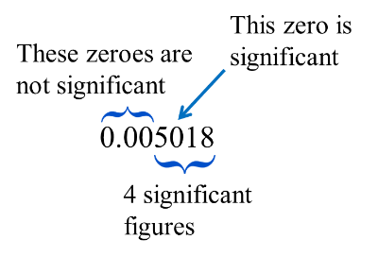
Zeroes found between two non-zero digits are always significant.
Zeroes to the left of the first non-zero digit are never significant.

Slide 6
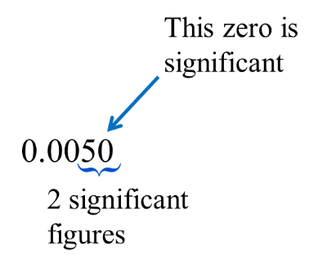
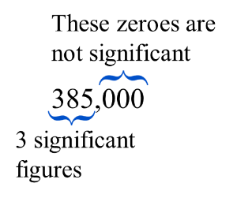
Remember, significant figures tell you about the accuracy of a number. The more significant figures there are, the more accurate the number is.
Zeroes to the right of the last non-zero number are not significant if the number is not a decimal.
If the number is a decimal, the zeroes to the right of the last non-zero number are significant, because they indicate how accurate the number is. This zero shows you that there is a zero there, and not some other number.

Slide 7
Let's see how this works with some examples
- | The number 385000 has 3 significant figures. The zeros on the right do not get counted because there is no non-zero digit after them.
- | The number 407300 has 4 significant figures.
- | The number 0.002 has 1 significant figure.
Now let's practise working out how many significant figures some numbers have.

Slide 8
Sometimes it makes more sense to round to a number of significant figures rather than decimal places. Using significant figures is a way to maintain the same level of accuracy.
For example, if we have measured the diameter of a circle to be 3.5cm, it would be misleading to say that the circumference is:
π×3.5cm=10.9955742875643 cm
This is a very accurate number - far more accurate than what we measured!

Slide 9
When giving an answer in science, it should be given to the same number of significant figures as the number with the fewest significant figures in the question.
So since we have measured the diameter of the circle to 2 significant figures, it is appropriate to also round the calculated circumference to 2 significant figures:
3.5π cm=11 cm(2 sig. fig.)

Slide 10
Now let's have a go at rounding using significant figures.
e.g. Round 5178 to 2 significant figures.
First we notice that 5178 currently has 4 significant figures.
We want to look at the third significant figure to determine if we round the second significant figure up or down.
Here this number is a seven: 5178
So we round the second significant figure up.
Therefore, 5178 rounded to 2 significant figures is:
5200
Now let's see how significant figures work with scientific notation.

Slide 11
Using significant figures with scientific notation is exactly the same. For example:
Round 1.054×10⁻⁵ to 2 significant figures.
We know that we only need to look at the number in front since powers of ten are not counted as significant figures. We know that 1.054 has 4 significant figures and we want to round it to 2 significant figures.
So, we look at the third significant figure. Here, this is a 5. So the second significant figure gets rounded up.
So 1.054×10⁻⁵ rounded to 2 significant figures is:
1.1×10⁻⁵
Let's practise using significant figures with scientific notation now.

Slide 12
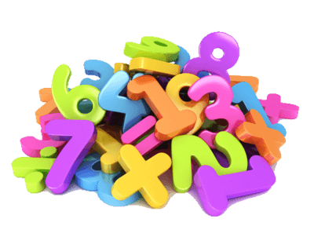
In this Smart Lesson, you have learnt about significant figures.
Can you answer the following questions?
• | What is the number of significant figures a measure of?
• | How are significant figures counted?
• | How do you round with significant figures?
Feel free to go back and revise this lesson if you don't know the answers to these questions.

Slide 13
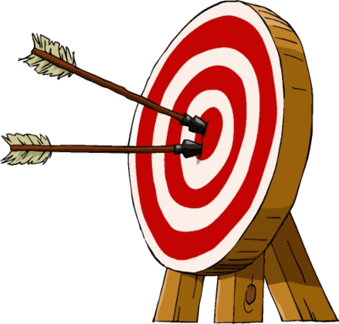
The number of significant figures is a measure of how accurate a number is.
For example, the number 23 has 2 significant figures. This is less accurate than the number 23.4, which has 3 significant figures.

Slide 14
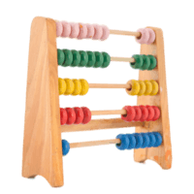
To determine whether or not a digit is significant, follow these rules:
• | Non-zero digits are always significant.
• | Zeroes between two non-zero digits are always significant.
• | Zeroes to the left of the first non-zero digit are never significant.
• | Zeroes to the right of the last non-zero digit are significant if the number is a decimal, but not significant if the number is not a decimal.

